Slide 1



Air France Case Study
TEAM 16
Albina, Belinda, Shantanu, Xavier

Slide 2
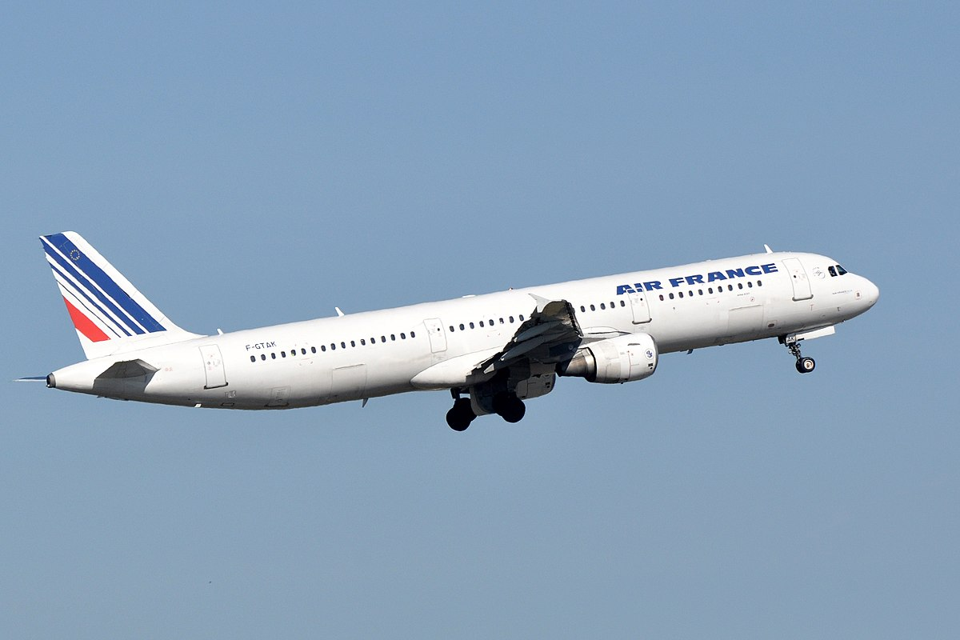






About Air France
552 aircrafts
341 destinations
98.7 M customers
27.18 B revenue in 2019
1.14 M cargo
80,595 employees
2

Slide 3
Business Problem
How can Air France optimize their Search Engine Marketing Strategy?

Slide 4

Business Insights
50% of passengers:
Clicked 4 times on keyword online ads
The average cost per click is $6.76
There were 176 impressions on keyword ads to book Air France tickets
1763 bookings were done on Broad search.
4

Slide 5
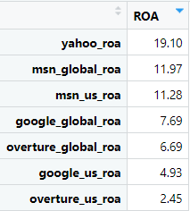
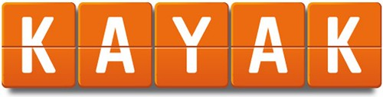
Publishers Return On Advertising
Net Revenue: $230,126.87
Media Cost: $3,567.13
ROA: 64.51 %
Kayak has an ROA 3.39x larger than Yahoo – US. Such a gap suggests that Air France gains better returns on Kayak versus other search engines.
5

Slide 6
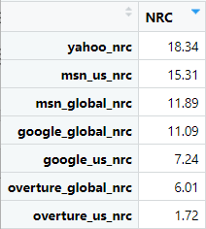
Publishers Net Revenue Per Click
Kayak’s ROA is ahead of the other Search Engines. Its NRC is 4.5x greater than the one of Yahoo – US.
Net Revenue: $230,126.87
Number of click: 2,839
NRC: $81.06
6

Slide 7
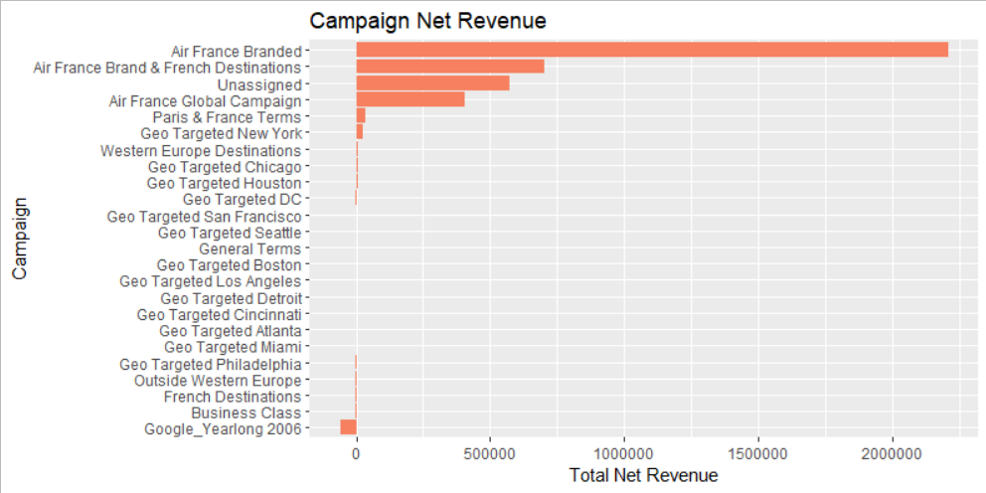
Campaigns Net Revenue
The campaigns with the greatest amount of net revenue:
Air France Branded, Air France Brand & French Destinations, Unassigned, and Air France Global Campaign.
7

Slide 8
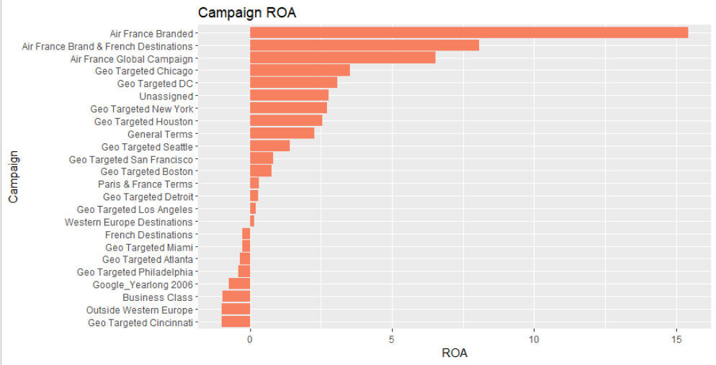
Campaigns ROA
The campaigns with the greatest ROA:
Air France Branded, Air France & French Destination, Air France Global Campaign
8

Slide 9
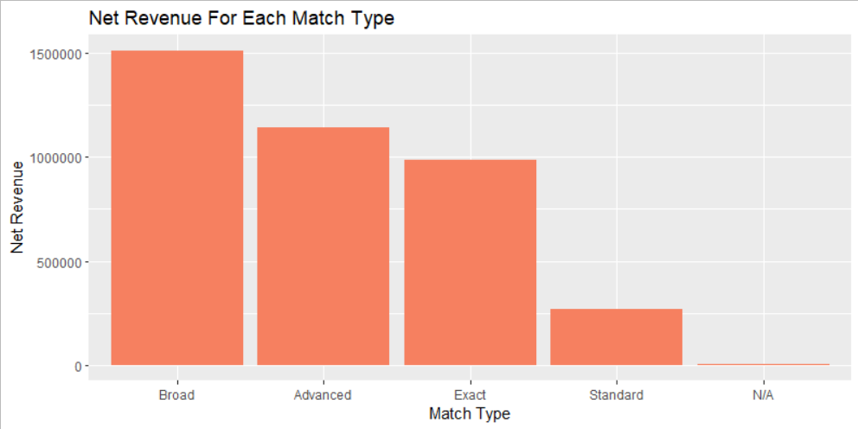
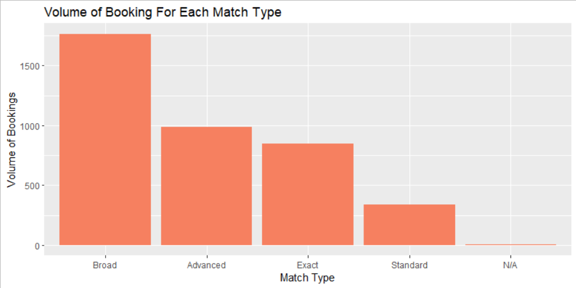
Match Type against Net Revenue and Bookings
Match Type Net Revenues
Match Type Volume of Bookings

Slide 10
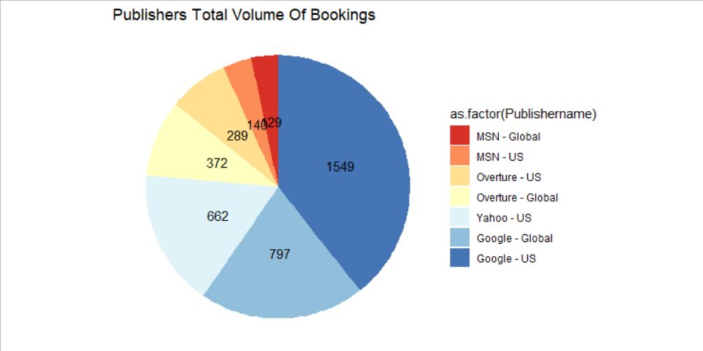
Publisher Volume of Bookings
Kayak’s Total Volume of Bookings equals 208.
Google and Yahoo represent more than 75% of overall bookings.

Slide 11
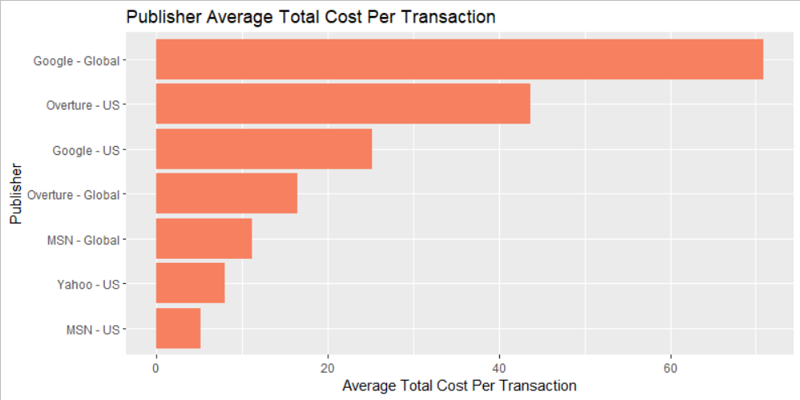
Publishers Total Cost Per Transaction
Kayak’s Average Cost Per Transaction is $17.15 (208 Bookings and $3,567.13 Media Cost), below Google – US.
Based on ROA and NRC, Overture – US and Global are costing Air France without much return.

Slide 12
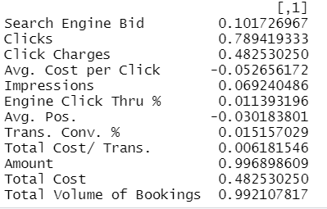
Correlation Table
Relation with Net Revenue:
Correlation Table
Net Revenue is strongly correlated with three other features:
Clicks: 0.79
Amount: 0.99
Bookings: 0.99
LHR
AMS
CDG
DEL
Net Revenue is mildly correlated with:
Click Charges: 0.48
Total Cost: 0.48
BOM
BGL
MAA
Notes:
Only two variables are negatively correlated with Net Revenue. The average cost per click and the average pos. This means every time the cost per click increases, the net revenue decreases. What is surprising here is the positive relationship between total cost and net revenue. It might be explained by the fact that in order to increase revenue, it is often needed to increase spendings as well. This coefficient, however, is only true up to a certain limit.

Slide 13



Recommendations
Increase investment in Yahoo and Kayak.
Overture should be reduced or cancelled.
Increase investment for Broad match type. Standard should be reduced, and N/A match type should have a specific grouping.
Investments in campaigns with the words Air France should be increased. Also focus on improving advertisements for Geo Targeted US Cities.

Slide 14

Thank You!
TEAM 16
Albina, Belinda, Shantanu, Xavier

